Slide 1
Overview of Life in Lakes

Slide 2

Guadalupe Bass

Slide 3
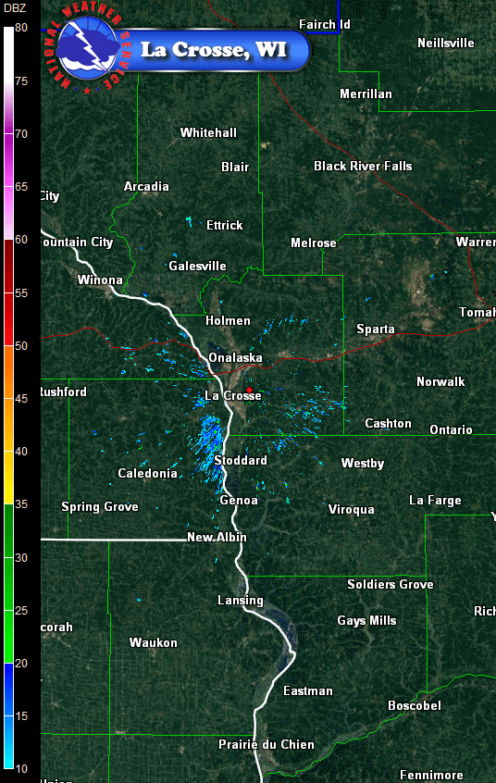

Slide 4
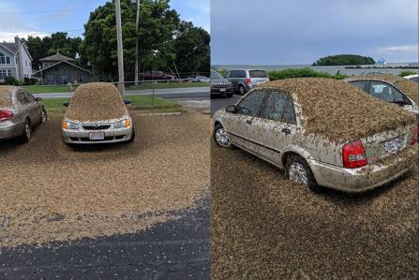
https://www.youtube.com/watch?v=AVOG34uht_Y

Slide 5
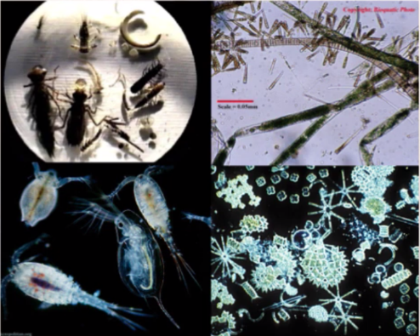
10-20 mm
Ecosystem functioning in lakes is dominated by small things
1-2 mm
50-100 microns

Slide 6
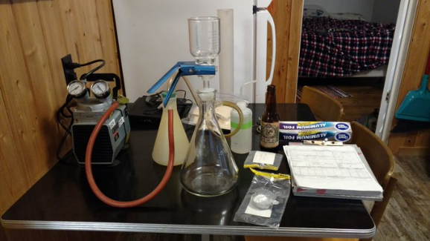
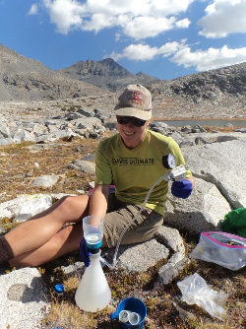
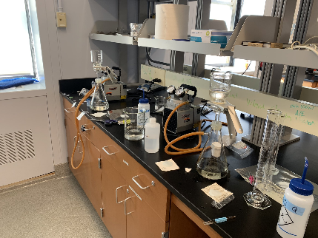
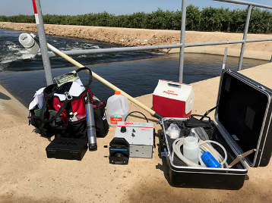

Slide 7
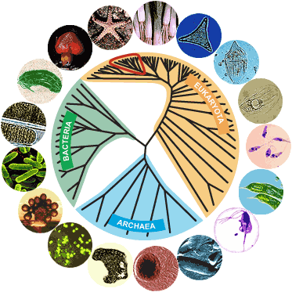
Life in lakes is diverse, crossing all domains of life

Slide 8
crustaceans, insects, mollucks, clams, worms, fish
Life in lakes is diverse, crossing all domains of life
green algae
fungi
diatoms
cyanobacteria
protozoans
bacteria
halophiles & thermophiles

Slide 9
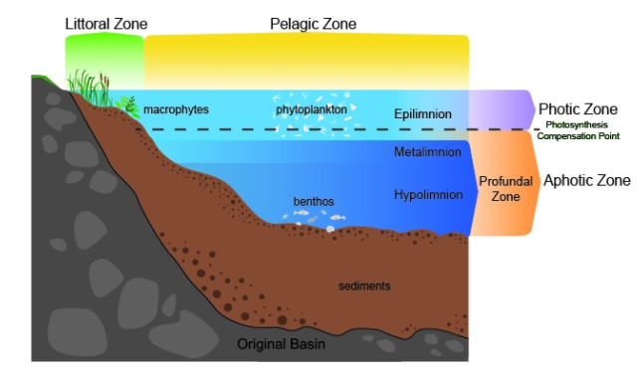
Habitats of Lakes

Slide 10
Habitats of Lakes

Slide 11

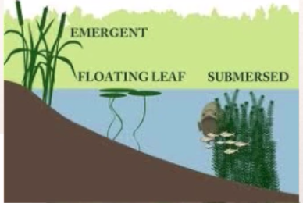
Littoral Zone

Slide 12
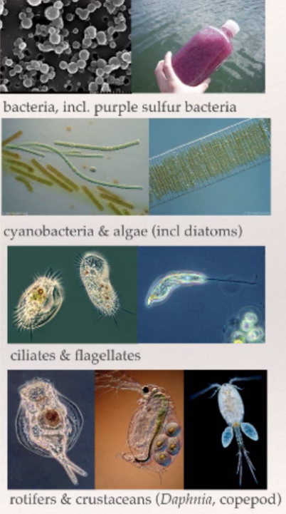

Pelagic Zone

Slide 13
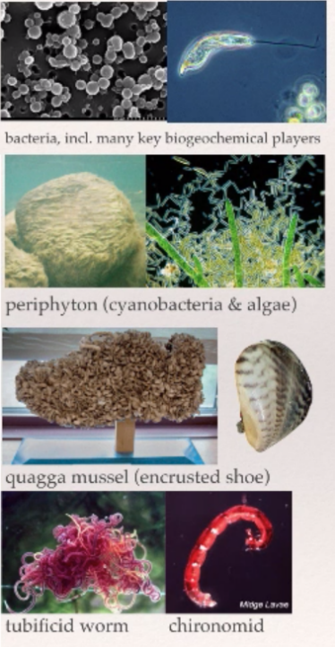
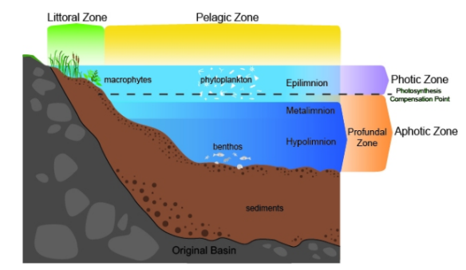
Benthos

Slide 14
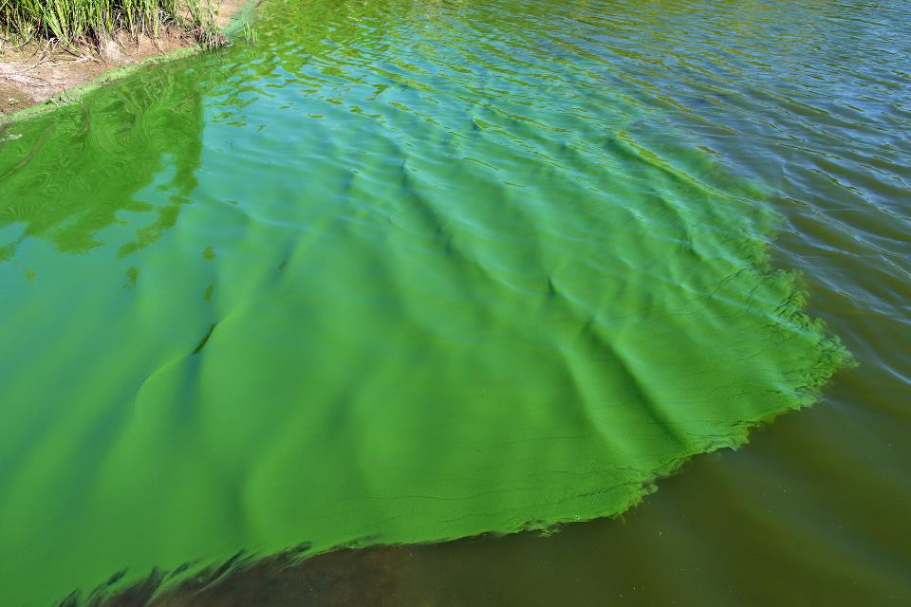

Slide 15
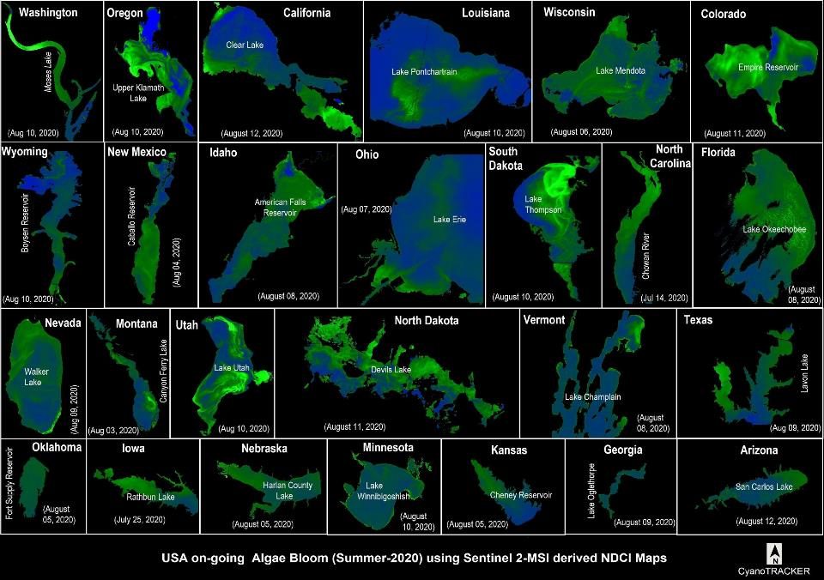

Slide 16
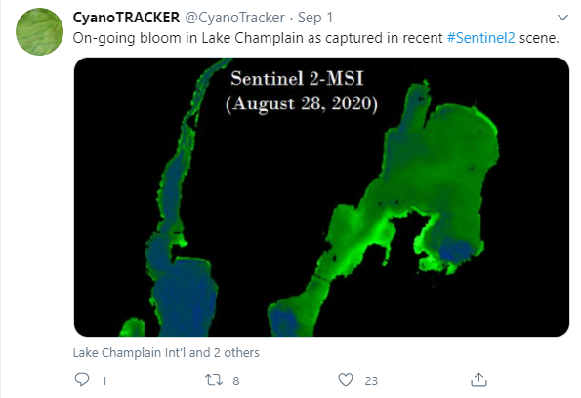

Slide 18


Slide 19



Slide 20
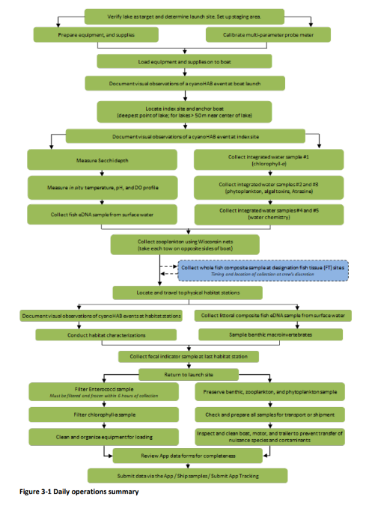

Slide 21
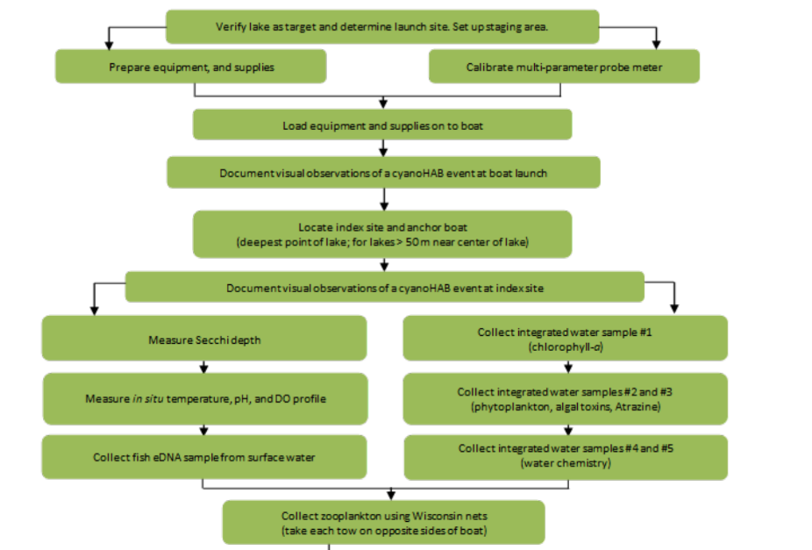

Slide 22
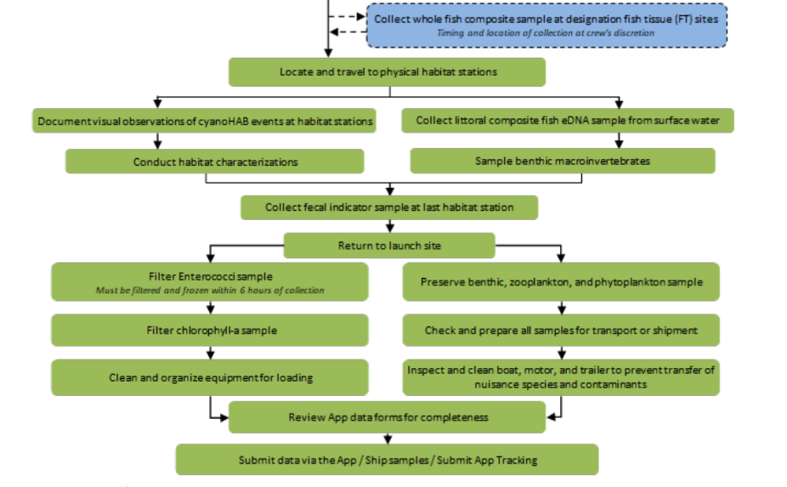

Slide 23
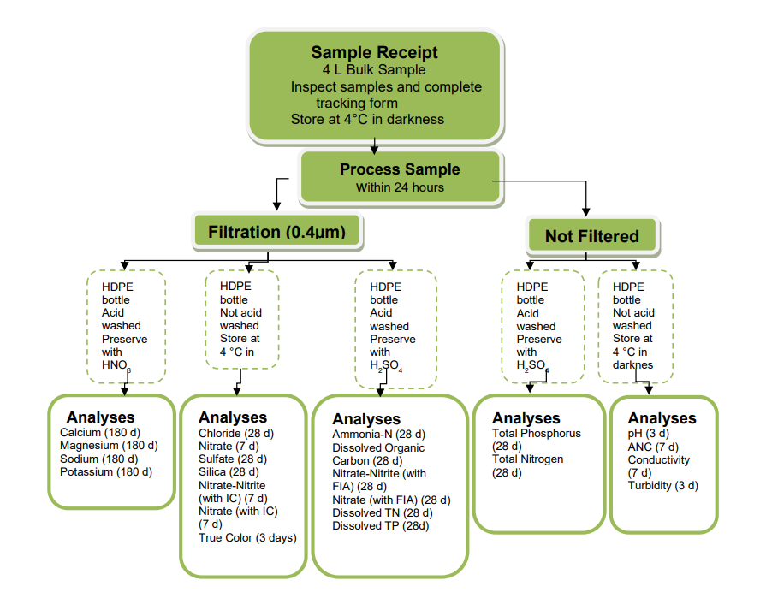

Slide 24
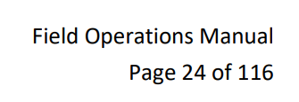


Slide 25
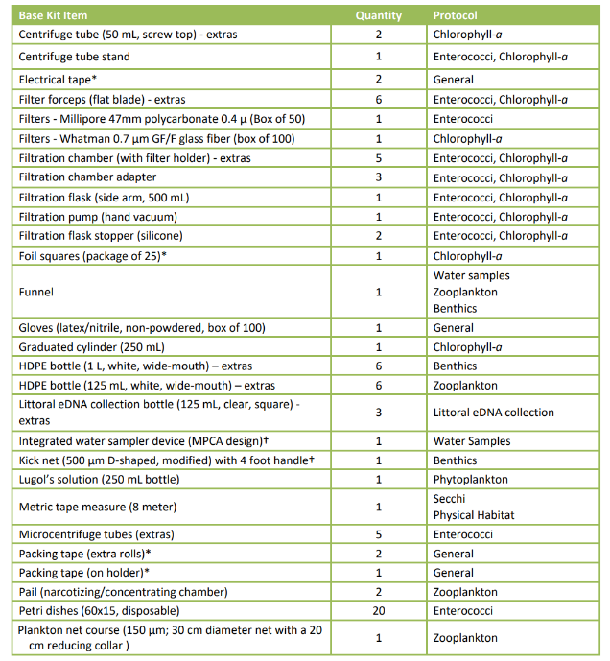

Slide 26
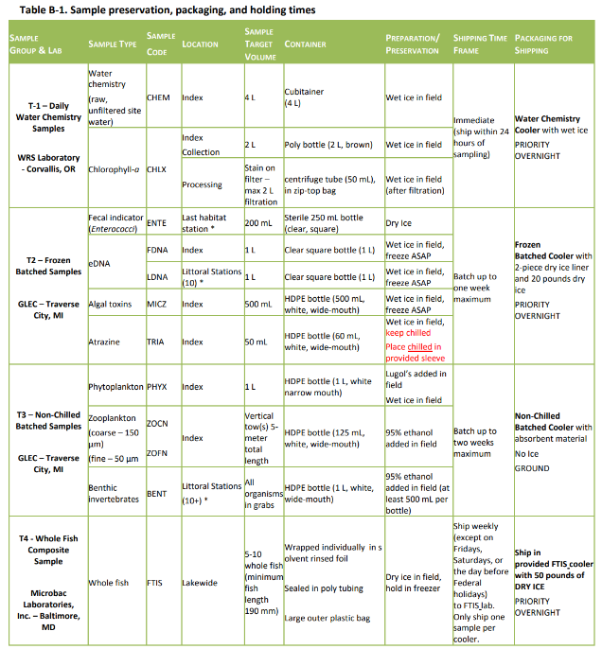

Slide 27
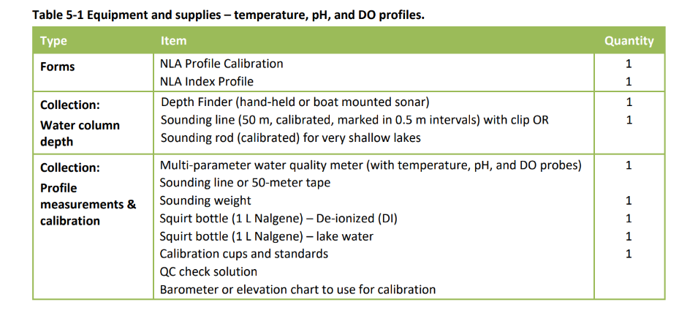

Slide 28
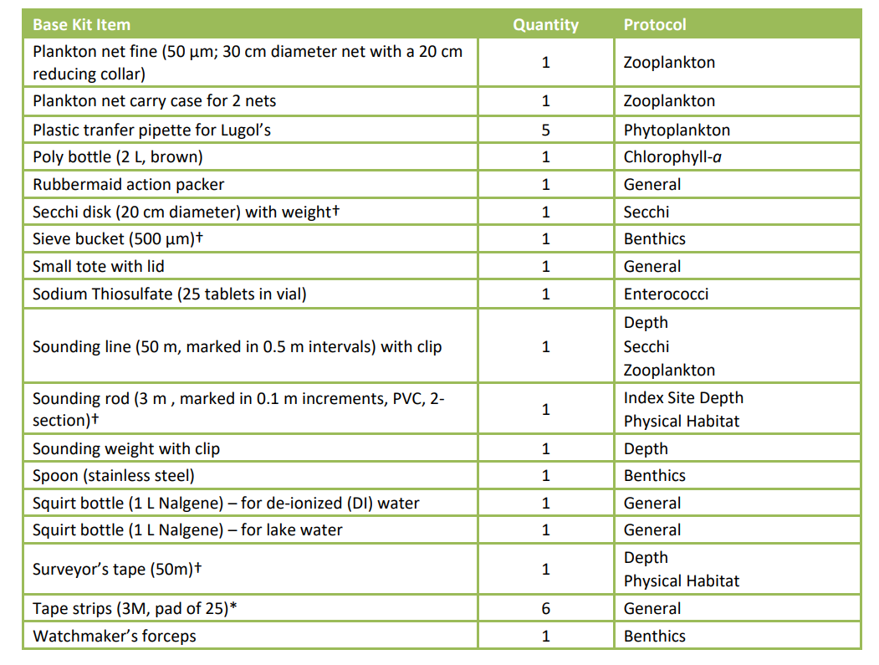

Slide 29
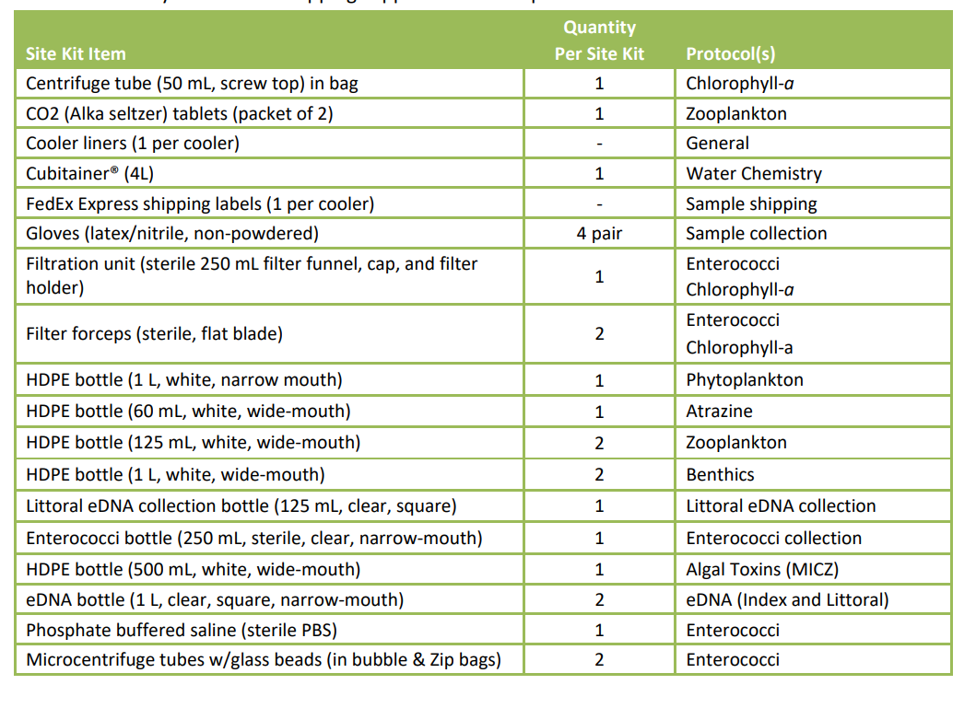

Slide 30
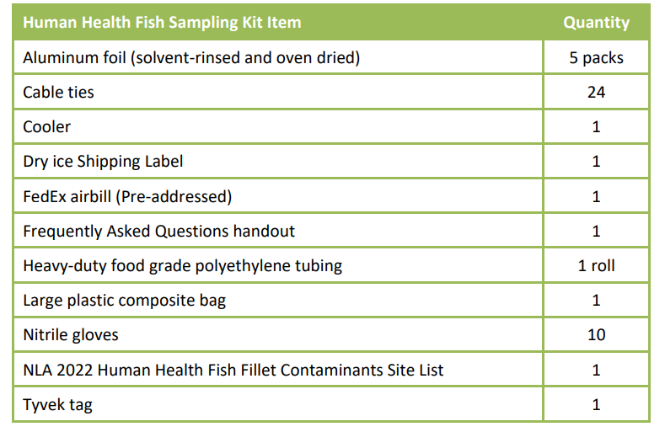

Slide 31
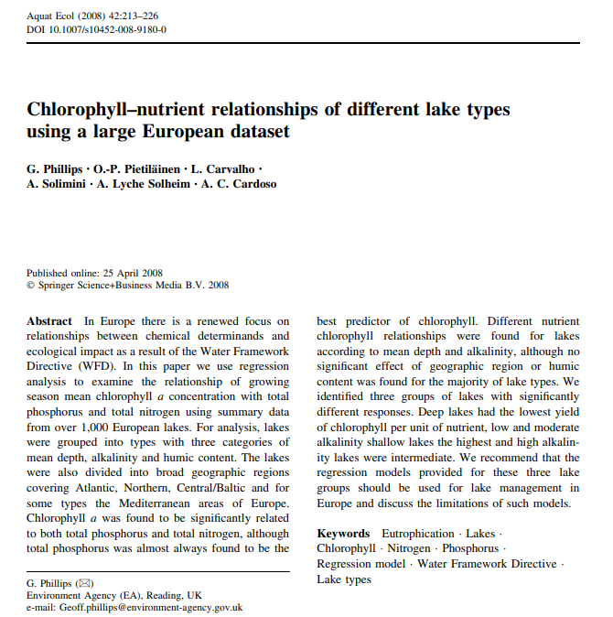

Slide 33
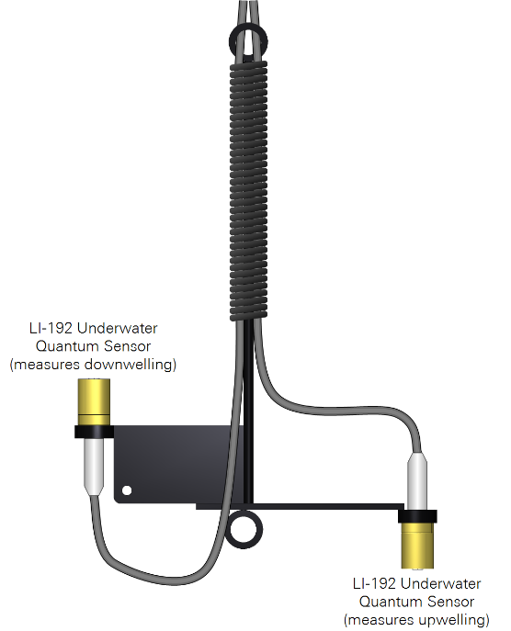
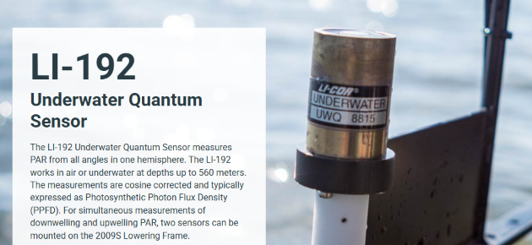
Photosynthetic photon flux density (PPFD)
micromoles per square meter per second (μmol·m⁻²·s⁻¹)
1000-2000 μmol·m⁻²·s⁻¹
at surface around midday

Slide 34
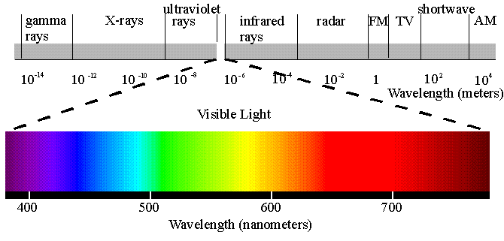
Energy distribution of light
Most energetic, most absorbed by air and water
UV-C, <280 nm
UV-B, 280-320
UV-A, 320-400
Least energetic, least absorbed by air and water
Photosynthetically Active Radiation (PAR): 400-700 nm

Slide 35
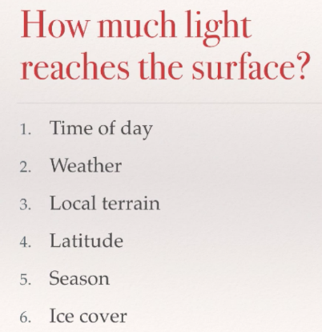
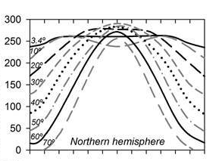
Radiation under cloudless sky (J cm⁻² d⁻¹)

Slide 36
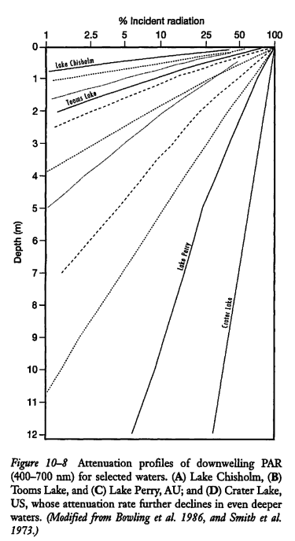
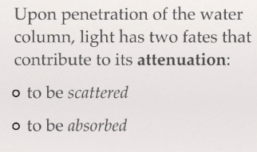
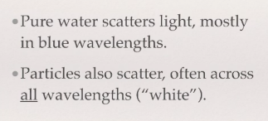
-Pure water
-Dissolved substances
-Inorganic particles
-Organic particles

Slide 37
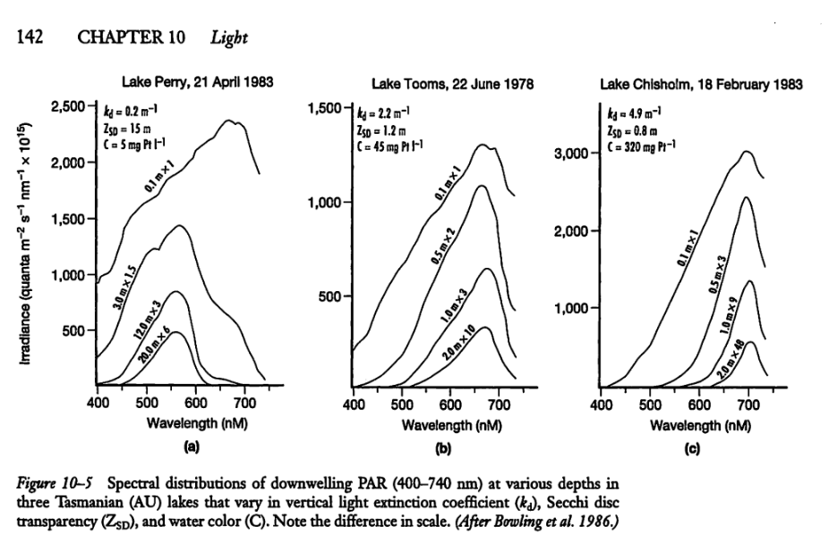

Clear lake, loss of
red and blue
Plankton lake, peak shift
toward green
Humic/brown lake, peak- shift to red

Slide 38
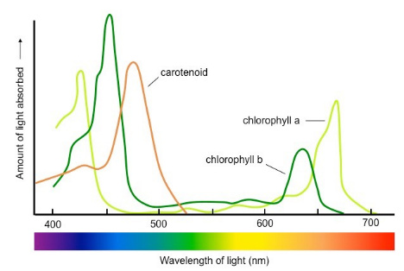
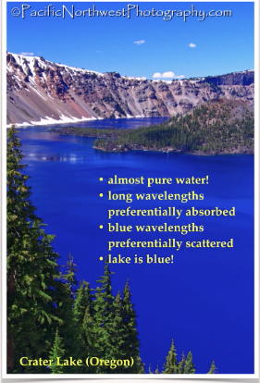
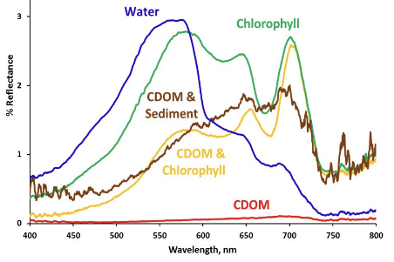
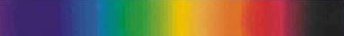
Olmanson et al. 2016

Slide 39
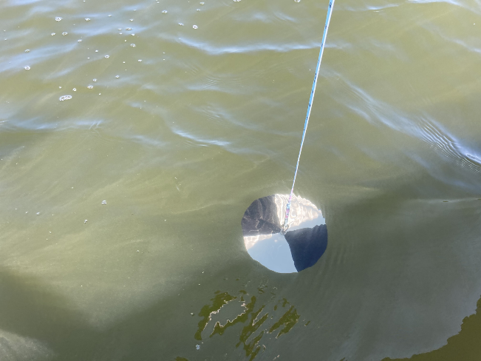

Slide 40
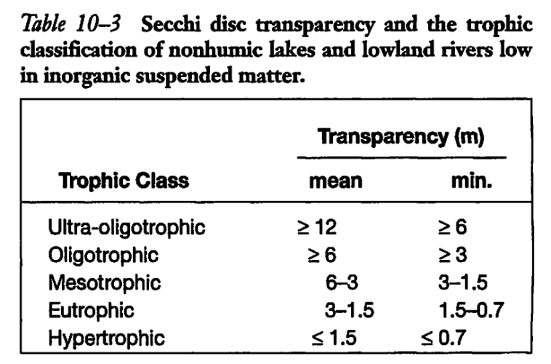

Slide 41
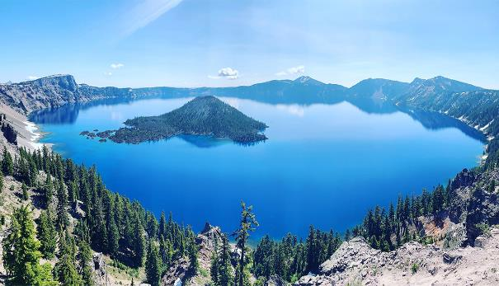
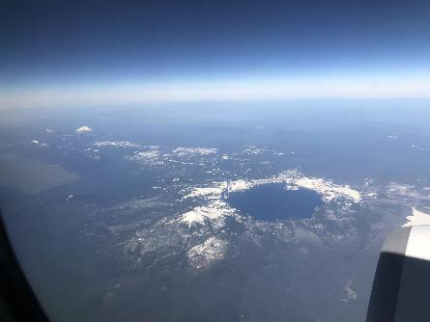
Crater Lake, Oregon
594 m deep! (1949 ft)
Secchi depth
~30 m (100 ft)

Slide 42

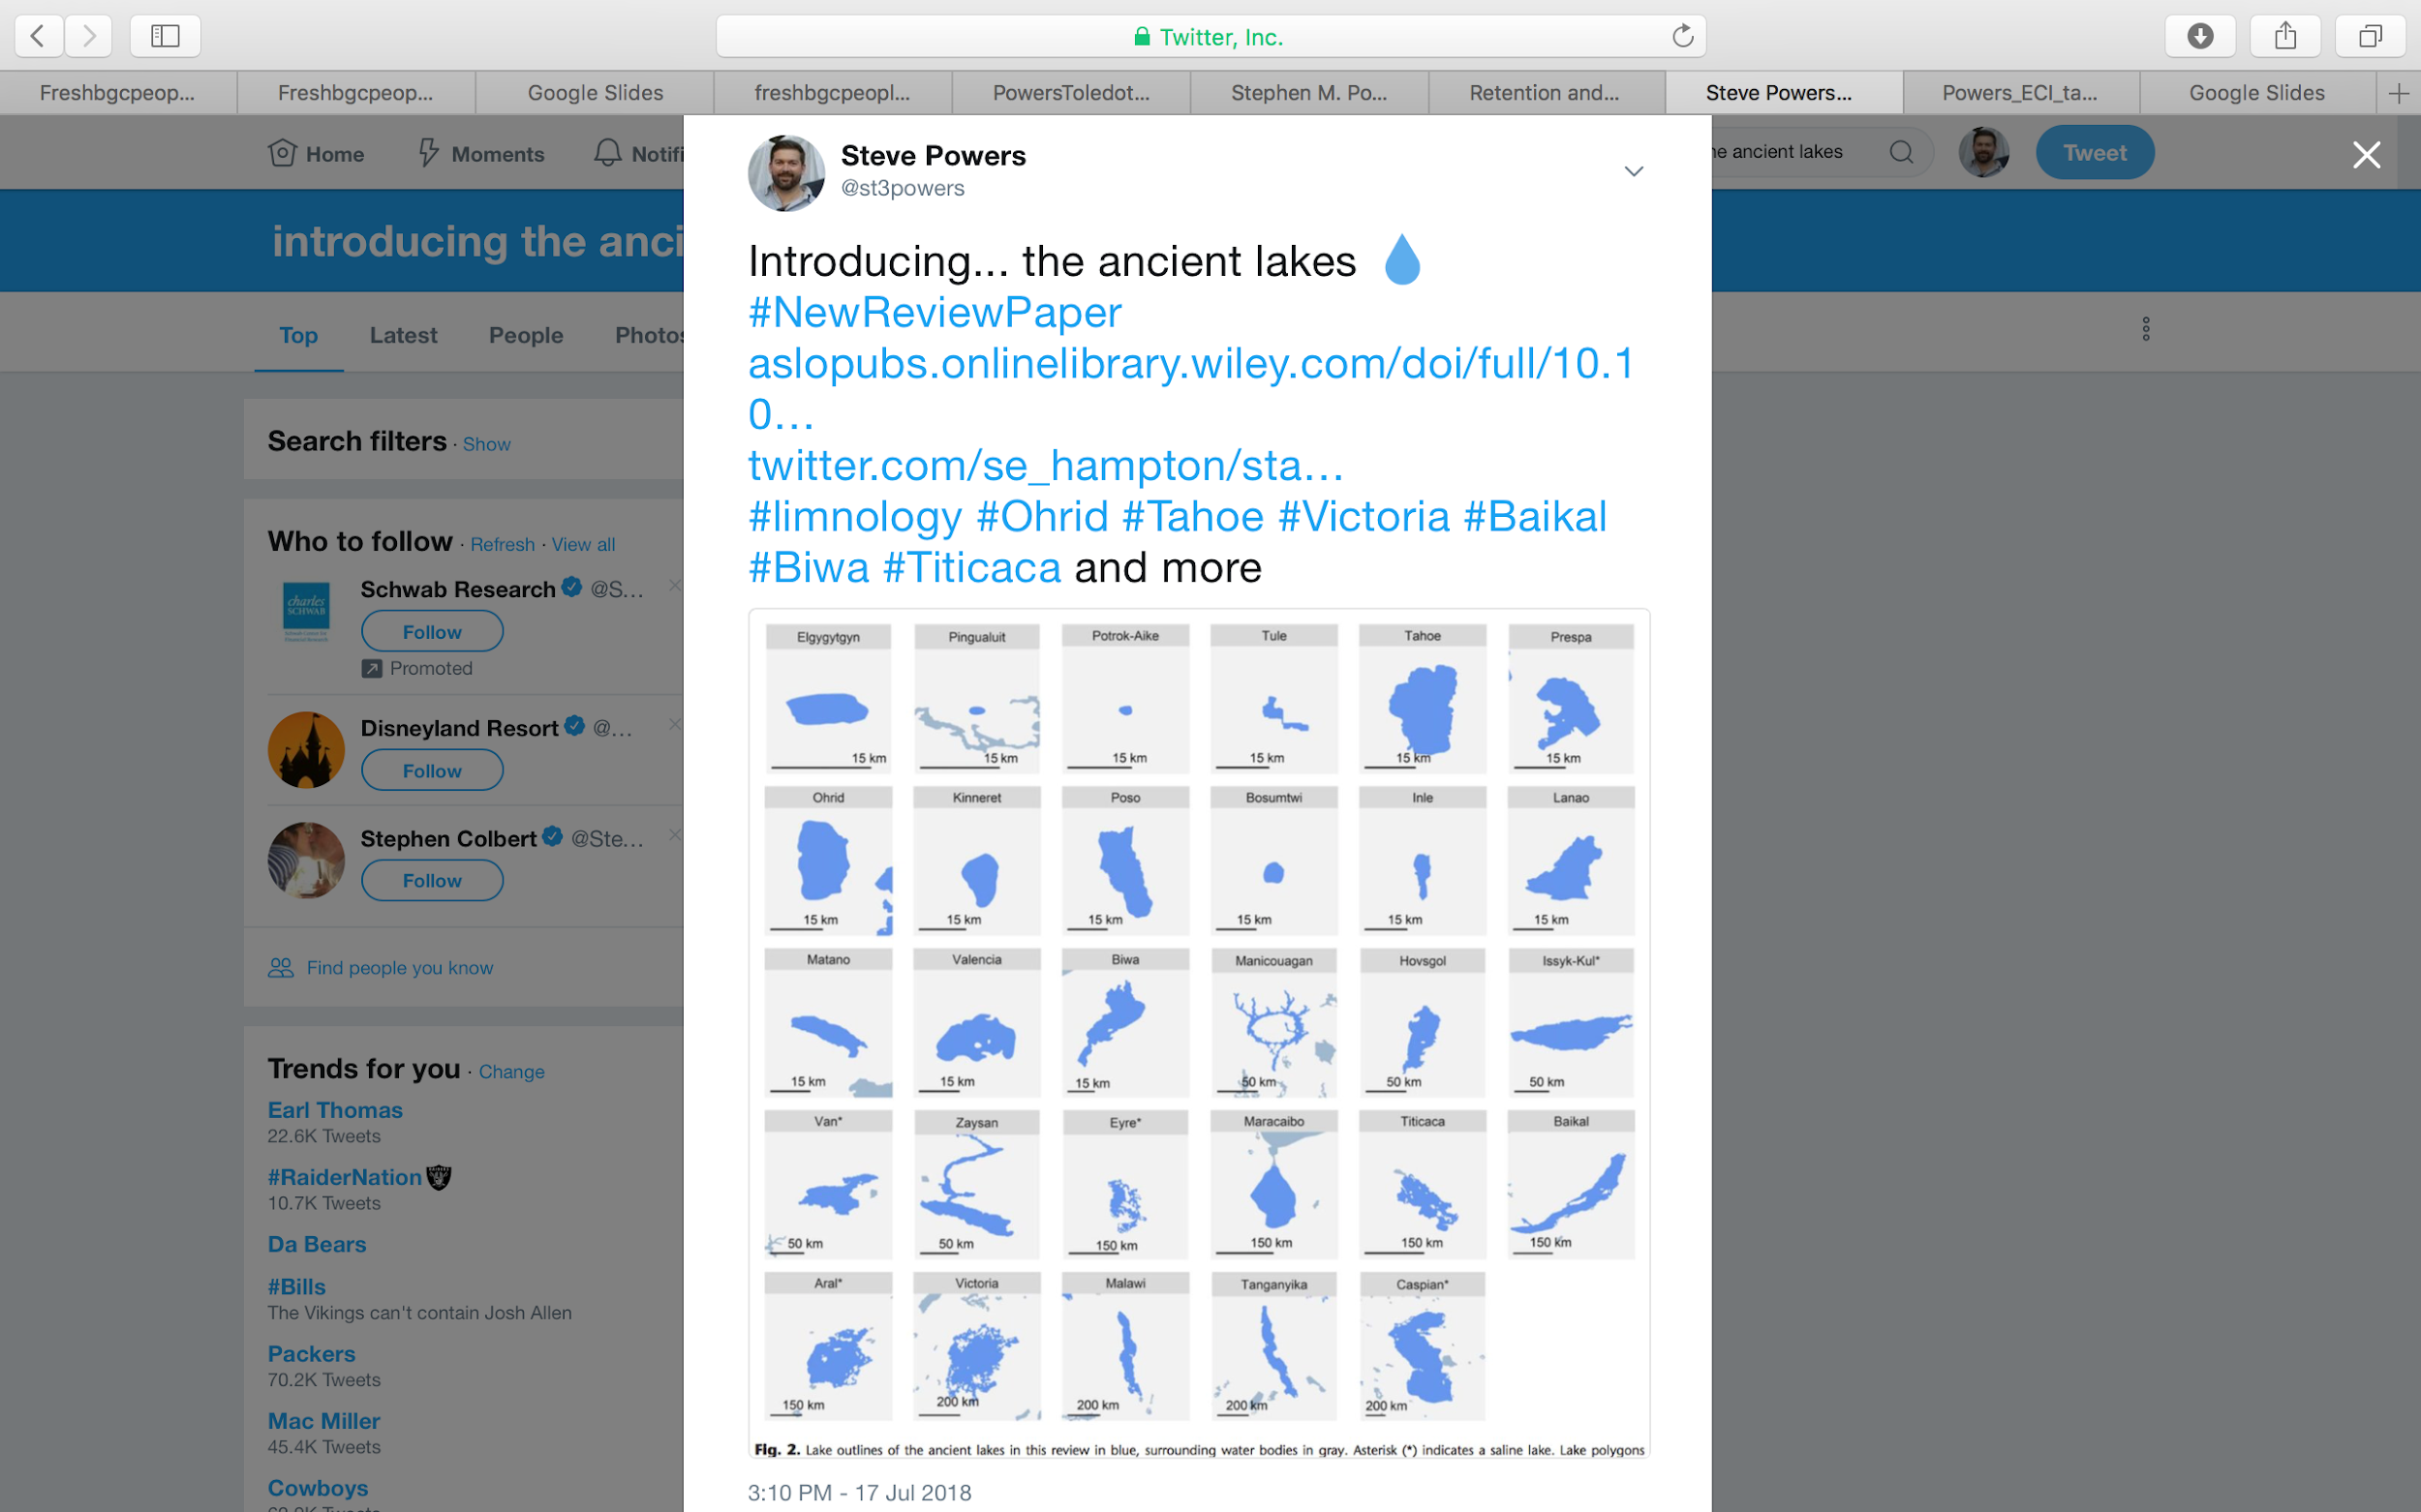

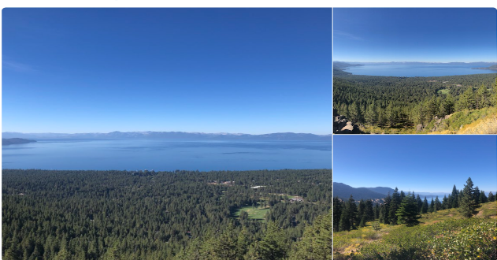
OHRID, MACEDONIA
TAHOE, USA

Slide 43
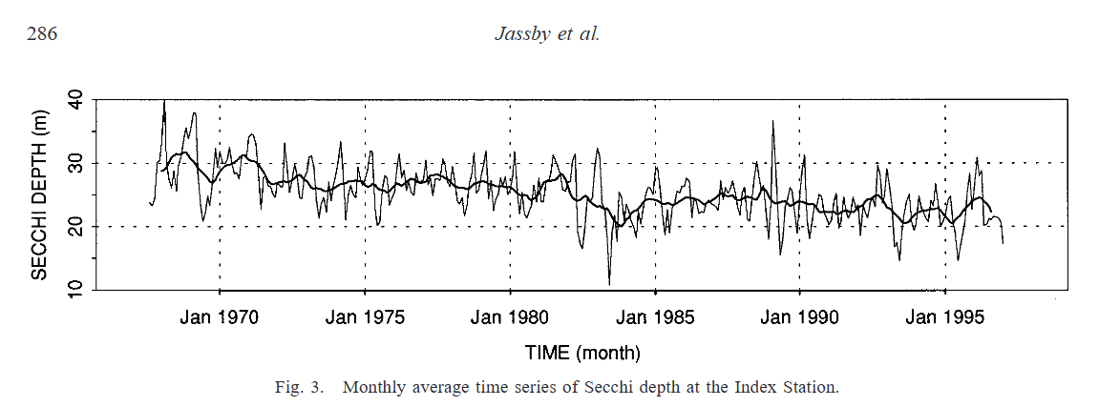
TAHOE, USA

Slide 44
OHRID, MACEDONIA
TAHOE, USA

Slide 45

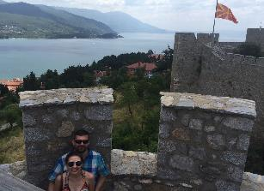
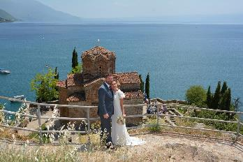
OHRID, MACEDONIA

Slide 46



Slide 47


Slide 48


Absorption of light is exponential
Wetzel 2001
Kalff

Slide 49
Absorption of light is exponential
k_{d} = vertical extinction coefficient*
k_{d} = (ln I₀ - ln I_{Z} ) / z
where I is photon flux density at surface (0) and at depth (Z)
k_{d}=k_{w}+k_{p}+k_{c}
Where:
k_{d}= total k,
k_{w}= ext. due to water
k_{p}= ext. due to particles
k_{c}= ext. due to dissolved components
Wetzel 2001

Slide 50
Mini report proposals

Slide 52
Exercises in Data
1. What is the Secchi Depth in Lake Waco?
2. What is the Secchi Depth in Clear Lake?
3. Which NLA lake has the deepest recorded Secchi depth?

Slide 54


Slide 55


Slide 56




Slide 57
Absorption of light is exponential
Wetzel 2001
Kalff

Slide 59
Absorption of light is exponential
k_{d} = vertical extinction coefficient*
k_{d} = (ln I₀ - ln I_{Z} ) / z
where I is photon flux density at surface (0) and at depth (Z)
k_{d}=k_{w}+k_{p}+k_{c}
Where:
k_{d}= total k,
k_{w}= ext. due to water
k_{p}= ext. due to particles
k_{c}= ext. due to dissolved components
Wetzel 2001

Slide 60


Slide 61


Slide 62


Slide 63


Slide 64



Slide 65


Slide 66


Slide 67


Slide 68


Slide 69


Slide 70


Slide 71


